Slide 2
Serverless Platform for Large Scale Apps:
From Knative to Production
Yitao Dong & Ke Wang

Slide 3
Self Introduction
@Matthew_Dyt (Twitter)
@KevinWang15 (GitHub)
Yitao Dong
Product Manager
@Ant Financial
Ke Wang
Software Engineer
@Ant Financial
Notes:
I’m Yitao, PM from Ant Financial. Most of my time is spent with financial customers adopting cloud native products. Together with my colleague, Ke Wang, our team has been working on a serverless platform(product) for large-scale apps.
Before we get started, I have 2 quick questions. How many of you have done a serverless demo on cloud? Please raise your hands. How many of you have been using serverless in production?

Slide 4
Agenda
Serverless Platform Use Case
Problems Along the Way
Our Attempts
Performance
Cost Reduction
Security
Cluster at Scale
Key Takeaways
Notes:
I’m Yitao, PM from Ant Financial. Most of my time is spent with financial customers adopting cloud native products. Together with my colleague, Ke Wang, our team has been working on a serverless platform(product) for large-scale apps.
Before we get started, I have 2 quick questions. How many of you have done a serverless demo on cloud? Please raise your hands. How many of you have been using serverless in production?

Slide 5

Serverless Platform Use Cases
Public Cloud
Apps for individual developers & small teams
Industry cloud for innovative businesses
On Premise
Autoscaling for time-critical workloads
Big data and machine learning tasks
Migrating monolithic apps to elastic / event-driven architecture
Notes:
Serverless is evolving very fast. If watching projects listed in Serverless Landscape by CNCF, you’ll be surprised at the progress. We already have containers, kubernetes and all those cool features. Why is Serverless so attractive? What makes the difference?
From my point of view, it's because of the 3 key capabilities. A) It sets us free from maintaining the infra and supports autoscaling from zero. B) We can start from code, zip file or images. C) It’s welled designed for consuming and producing events. With these capabilities, Serverless is better for many use cases in real world.
On public cloud, serverless can provide a super lightweight developer experience for individual developers who want to start their own websites or so-called mini-apps as fast as possible. Serverless also helps to grow the innovative business on industry public clouds where specific knowledge and resources are shared across the partners/tenants. In both cases, users no longer need to take care of or pay much for the cluster or pods, instead, they are enabled with resourceful APIs provided by the platform through BaaS.
For On-premise customers, Serverless also helps. With autoscaling, they are better prepared for peak online traffic, instead of spending hours with complicated k8s scaling rules and pre-pay for large numbers of machines. It largely unlocks the compute power occupied by big data and ML tasks by changing it into an on-demand model. And for the latency apps, lift-and-shift means much refactoring effort. Serverless offers another choice to make it elastic with event-driven architecture.

Slide 6

Some of the Obstacles Along the Way
Performance
Frustrating cold-start time with Knative on Kubernetes
Deteriorating performance at scale
Cost
High infrastructural costs to use Knative
Paying for nodes that are not actually in use
Security
Container escapes and other attack vectors
……
Notes:
Even though we find so many use cases, building a serverless platform is another story. If that's your goal, these are the difficulties you may have along the way.
Performance is the #1 concern. Any latency may lead to a catastrophe in production. However, at this moment, the cold-start time with Knative on Kubernetes is unsatisfying. And the performance becomes progressively worse at scale.
What's more, building a Serverless platform means that you'll have to maintain the infrastructures. It's not easy to build and maintain the multiple layers for kubernetes, mesh and serverless. Besides, the infrastructural costs is high if running knative directly.
Last but the least, since serverless adopts an infrastructure that shares more infra layers. It's good for customers to make better use of the CPU/Memory. But it also brings security concerns that there're untrusted users sharing the same node. How can the platform help them to address those security issues?

Slide 7



Our Attempts to …
Performance of a Serverless Platform Based on Knative
Reducing the Cost of Running a Serverless Platform
Serverless Platform at Scale

Slide 8

Performance
A new pod takes a long time to start…
In a cluster with ~1000 nodes
Scheduling: ~10 seconds
Docker Image Pull: 1-10 seconds (depending on image size)
Container Start Up: ~1 second
K8S Pod Ready: ~2 seconds
Registered to Service Mesh: ~5 seconds
A cold start that takes 20 seconds is quite common.

Slide 9

Performance
Nobody wants to wait for 20 seconds..
When they visit your website

Slide 10
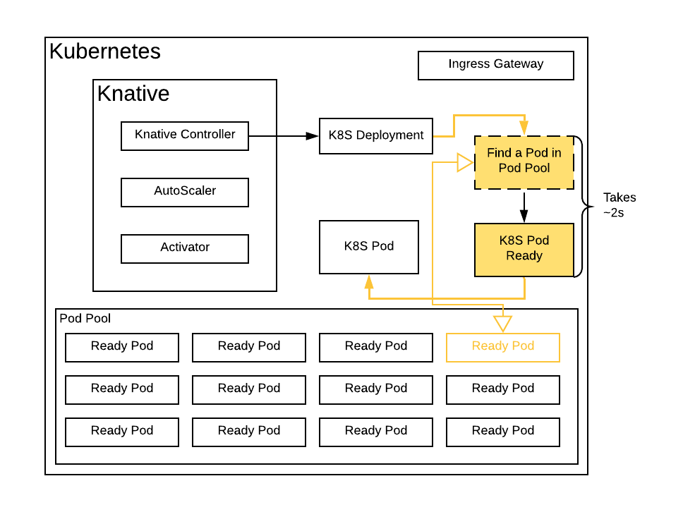

Performance
Pool based
pre-warming solution
to
drastically cut cold-start latency
Notes:
Refactoring Knative workload: starting up containers (VMs) ahead of time and keeping a ready-to-go instance pool of a certain size, instead of cold-starting the containers on demand. (If you are using cluster-autoscaler to provision nodes, this method also saves the cluster-autoscaler node cold-start time.)

Slide 11
Performance
Implementation — creating a new Deployment (CRD) and its controller
CustomResources that are the equivalent of Deployment and ReplicaSet.
Fork code of Controller Manager to handle the CRs.
Instead of creating new Pods, choose a pre-warmed pod from the pool.

Slide 12
Performance
Implementation — adopting a prewarmed pod
HTTP/gRPC for FaaS scenarios
alternative: Downward API + Volume Mount + File Watcher
Using Ephemeral Containers
Patching kubelet to enable substitution of Pod containers at run time
Notes:
This is quite difficult.. Please stay open-minded

Slide 13
Performance
Implementation — maintaining the size of the pool
An algorithm that automatically adjusts the size of pool based on its usage.
Scale out / scale in based on metrics
Slow & delayed scale in
Fast & immediate scale out

Slide 14

Performance
Average Cold-Start Time After the Optimization:
1.8s
( measured with a very simple Java http server )
A 90% improvement,
Could mean the difference between adopting or not adopting scale-to-zero & cold start.

Slide 15

Performance
Further applications:
Service Mesh / Microservices
Framework that takes a long time to start..
Services that require to download a lot of data..
With resource pools / pre-warming,
applications running on Kubernetes generally can be not only reliable but also performant.
Maybe we should come up with a SIG to push this idea further?
Notes:
Pushing it further: start up JVM ahead of time, even some business-irrelevant frameworks can be started ahead of time. When 0-1 happens, the user code is injected and takes effect almost immediately (this also makes the transition to serverless easier as users only need to submit .jar's).

Slide 16
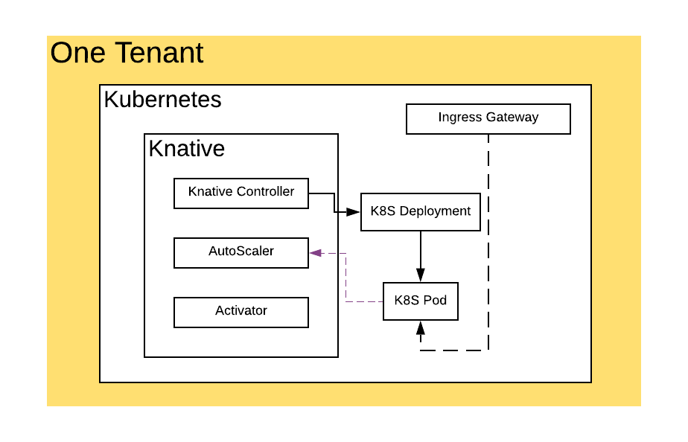
Cost Reduction
Knative control plan costs quite a lot of CPU & Memory to run..
Controller: 4C 8G
AutoScaler: 2C 4G
Activator: 2C 4G
K8S: 8C 16G
Istio Service Mesh: 8C 16G
……

Slide 17
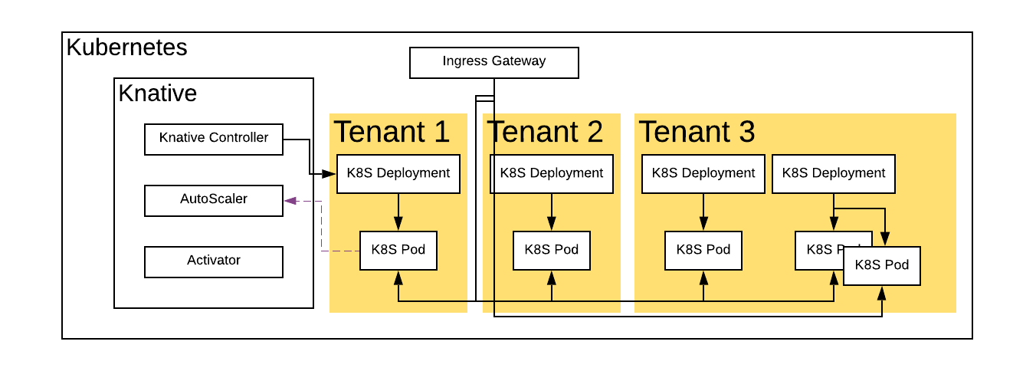
Cost Reduction
A shared control plan makes the cost of Knative to each individual user negligible.

Slide 18

Cost Reduction
How to achieve multitenancy?
Namespace-based multitenancy + RBAC
Multitenant K8S at Ant Financial (adding an extra layer of directory to etcd)

Slide 19

Cost Reduction
Other ways to reduce costs
cluster-autoscaler to automatically provision or release nodes.
virtual-kubelet to use other elastic computing services such as AlibabaCloud Elastic Container Instance or AWS Fargate.

Slide 20

Security
Security challenges to a Serverless Platform
Mutually untrusted users sharing a same K8S node
The default docker container runtime (runc) is prone to escapes

Slide 21
Security
Kata Containers - Each pod is a lightweight VM
Not sharing the same Linux Kernel makes escapes and attacks difficult

Slide 22

Cluster at Scale
In order to support
a large number of Serverless Apps,
the Sharding technique is used
Upstream system adds a partition id. (based on user id, app id, etc.)
Controller partitioning: multiple controller instances, each only acknowledging workloads with the same partition id as the controller.

Slide 23
Cluster at Scale
In order to support
a large number of Serverless Apps,
the Sharding technique is used
Autoscaler partitioning: multiple autoscaler instances, using DNS to route requests to the autoscaler with the same partition id.
Service mesh service group: each ingress gateway only serves a certain partition id.

Slide 24
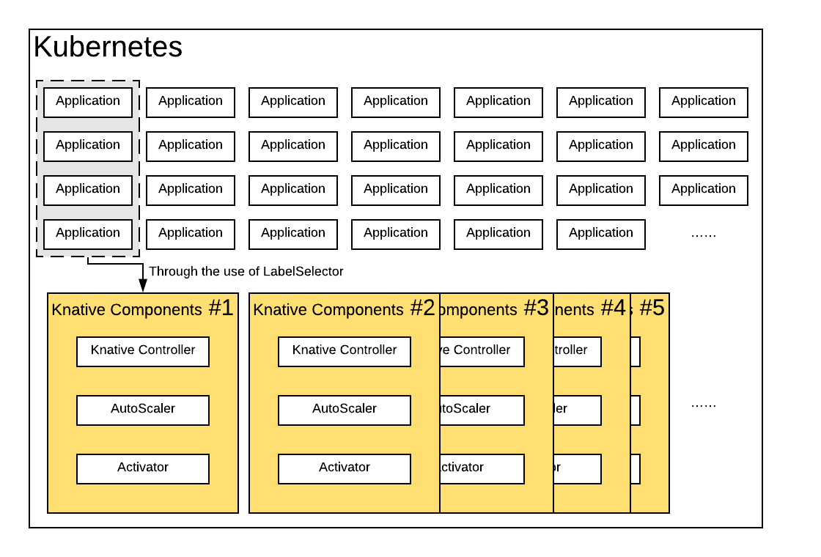
Cluster at Scale
1 set of Knative components (control plane + data plane) takes care of N applications
Use a label selector in the ListWatch so that a controller only reconciles its share

Slide 25

Cluster at Scale
Use multiple K8S clusters when K8S control plane becomes the bottleneck
Scaling out a Serverless cluster is generally quite easy
when partitioning / sharding is done well by an upstream system.

Slide 26

Key Takeaways
Pre-warming techniques can effectively solve performance problems in Knative / Kubernetes and its standardization can be beneficial to the eco-system.
Serverless is about sharing infrastructure. The more you share the lower the costs.
Use of sharding / partitioning techniques can effectively solve almost all scale-related problems faced by a Serverless Computing platform.

Slide 27
About SOFAStack
SOFAStack™（Scalable Open Financial Architecture Stack）
Managed service on Alibaba Cloud (Preview) - https://cn.aliyun.com/product/sofa
Open-source project on GitHub - https://github.com/sofastack
SOFAStack homepage - https://www.sofastack.tech/en/

Slide 28
Thank you!

